Slide 1
Knaive Bayes

Slide 2
Introduction:
The Naïve Bayes classifier is a supervised machine learning algorithm, which is used for classification tasks.
It seeks to model the distribution of inputs of a given class or category.
Naïve Bayes is also known as a probabilistic classifier since it is based on Bayes Theorem.
It is a probabilistic classifier, which means it predicts on the basis of probability of an object

Slide 3
Why is it called Naïve Bayes?
Naïve: It is called Naïve because it assumes that the occurrence of a certain feature is independent of the occurrence of other features.
Each feature individually contributes to identify without depending on each other.
Bayes: It is called Bayes because it depends on the principle of Bayes’ Theorem.

Slide 4

Bayes’ Theorem.
Bayes' theorem is also known as Bayes' Rule or Bayes' law, which is used to determine the probability of a hypothesis with prior knowledge. It depends on the conditional probability.
P(A|B) is Posterior Probability
P(B|A) is Prior Probability.
P(A) is Prior Probability
P(B) is Probability of Evidence

Slide 5
Assumption:
The fundamental Naive Bayes assumption is that each feature makes an:
independent
Equal
The assumptions made by Naive Bayes are not generally correct in real-world situations. In-fact, the independence assumption is never correct but often works well in practice.

Slide 6
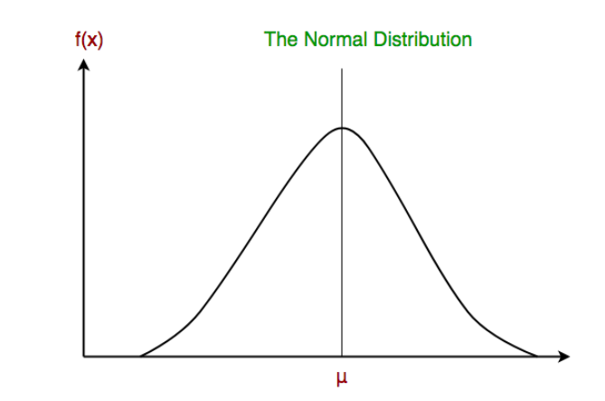
Different types of Naïve Bayes classifiers:
Gaussian Naïve Bayes Classifier: In Gaussian Naive Bayes, continuous values associated with each feature are assumed to be distributed according to a Gaussian distribution.
Multinomial Naive Bayes: Feature vectors represent the frequencies with which certain events have been generated by a multinomial distribution
Bernoulli Naive Bayes: In the multivariate Bernoulli event model, features are independent booleans (binary variables) describing inputs

Slide 7
Applications:
It is used for Credit Scoring.
It is used in medical data classification.
It can be used in real-time predictions because Naïve Bayes Classifier is an eager learner.
It is used in Text classification such as Spam filtering and Sentiment analysis.

